Slide 1
Stranding Data Analysis
Josh Meza-Fidalgo, Jess Ozog, Britney Pepper

Slide 2
Data
Stranding data collected by Mystic Aquarium
1990-2011
Curated and managed by OBIS-SEA
Strandings of cetaceans, pinnipeds, and turtles in the NE area
Cetaceans split into mysticetes and odontocetes

Slide 3
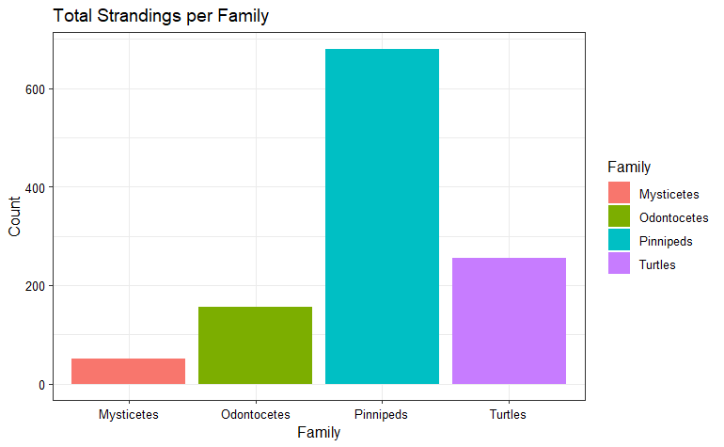

Slide 4
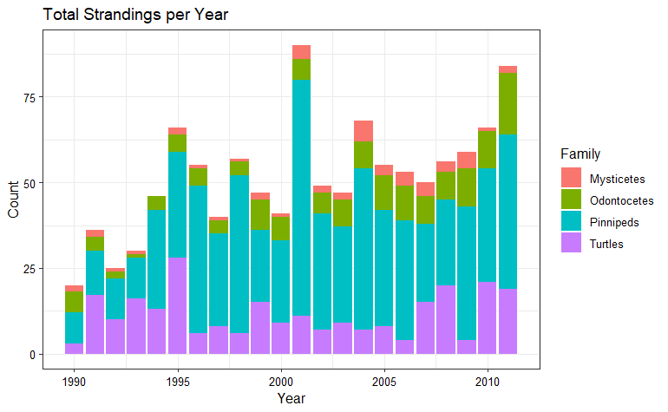

Slide 5
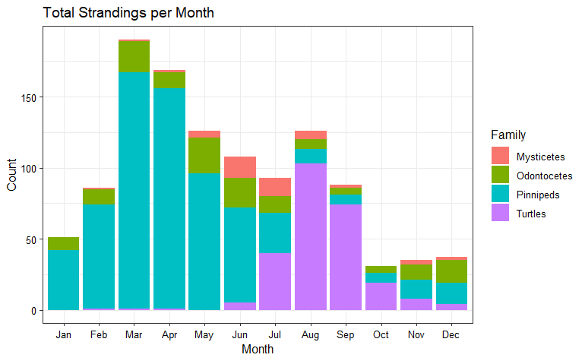

Slide 6
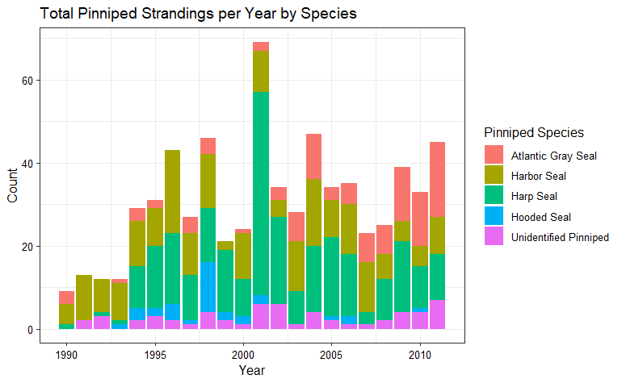

Slide 8
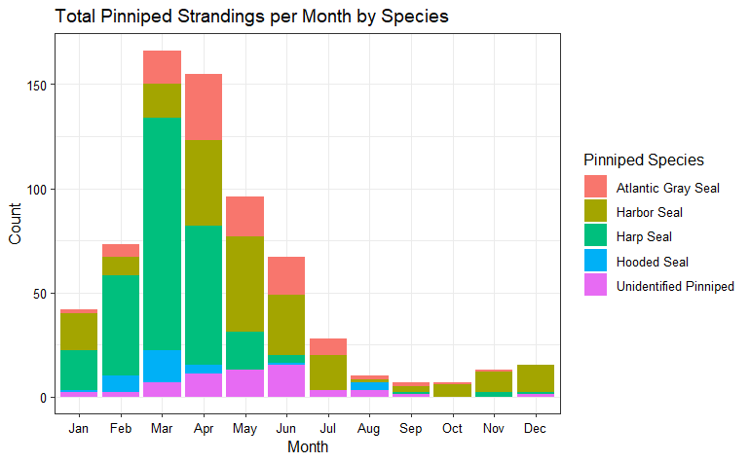

Slide 9
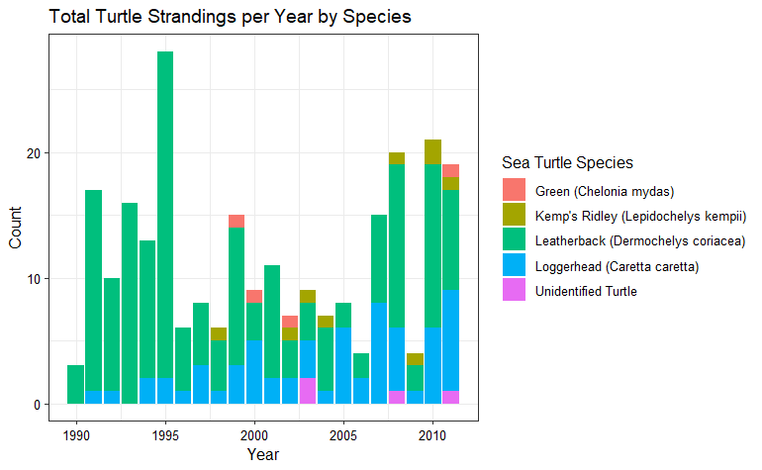

Slide 10
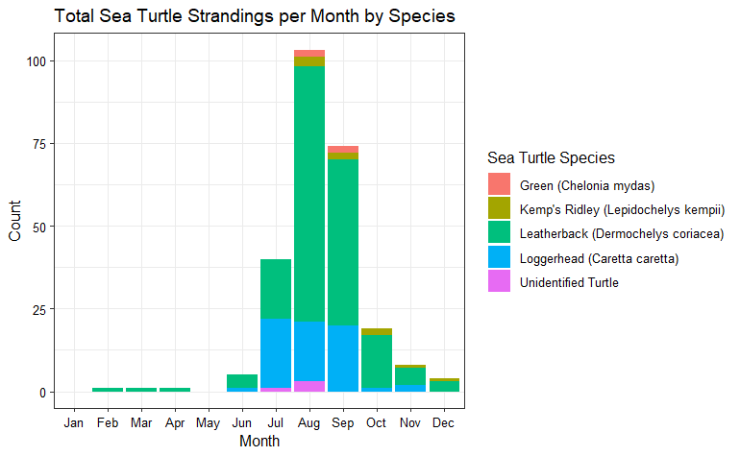

Slide 11
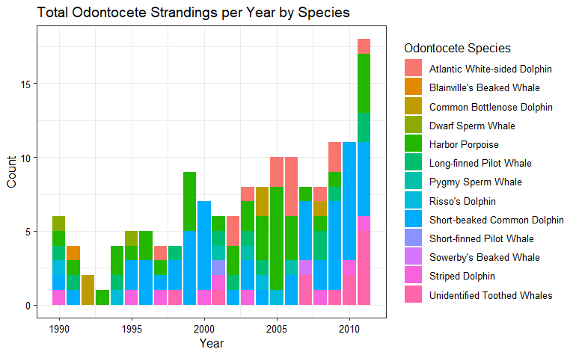

Slide 12
